Slide 1
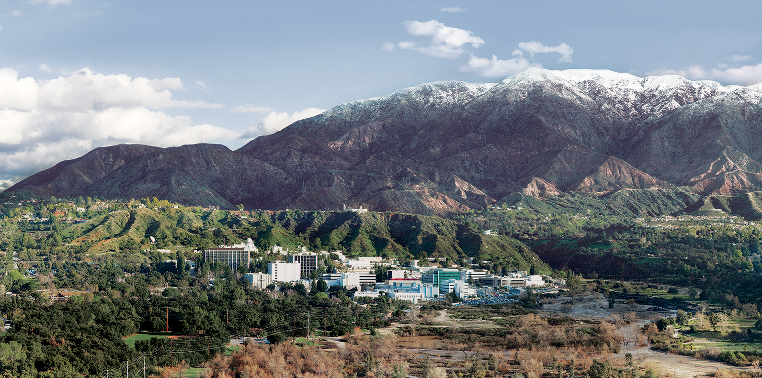
9. Atmospheric Correction (Classic Flavor)
Dr. David R. Thompson
Jet Propulsion Laboratory, Imaging Spectroscopy Group
July 20, 2019

Slide 2
Goals for this module
Transform reflectance to simulated radiance for a known observing geometry
Apply basic atmospheric effects of scattering and absorption
Invert measured radiances to estimate surface reflectance

Slide 3

Atmospheric correction
Aerosols
(absorption and scattering)
Atmospheric gases
(absorption)
Surface reflectance

Slide 4
Atmosphere varies over short spatiotemporal scales
“AVIRIS Classic” imaging spectrometer, visible wavelengths
Retrieved Water vapor
[Thompson et al., Surv. Geohysics, 2018]
Notes:
Spatiotemporal variability means we must estimate the atmosphere independently in each spectrum.

Slide 5
Absorption by gases in the Atmosphere
[Thompson et al., Surv. Geophys. 2019]

Slide 6
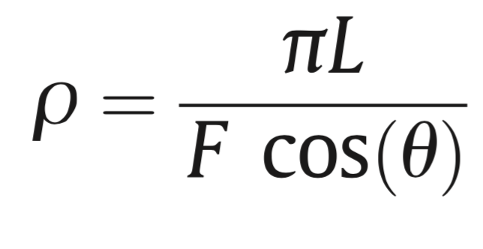
Top of Atmosphere (TOA) reflectance
Radiance at sensor
Solar irradiance
Solar zenith angle

Slide 7
Band depth H₂O vapor estimate
Continuum-interpolated band ratio:
C (bl – al) / [(cl – al) A + (bl – cl) B]
B
A
C

Slide 8
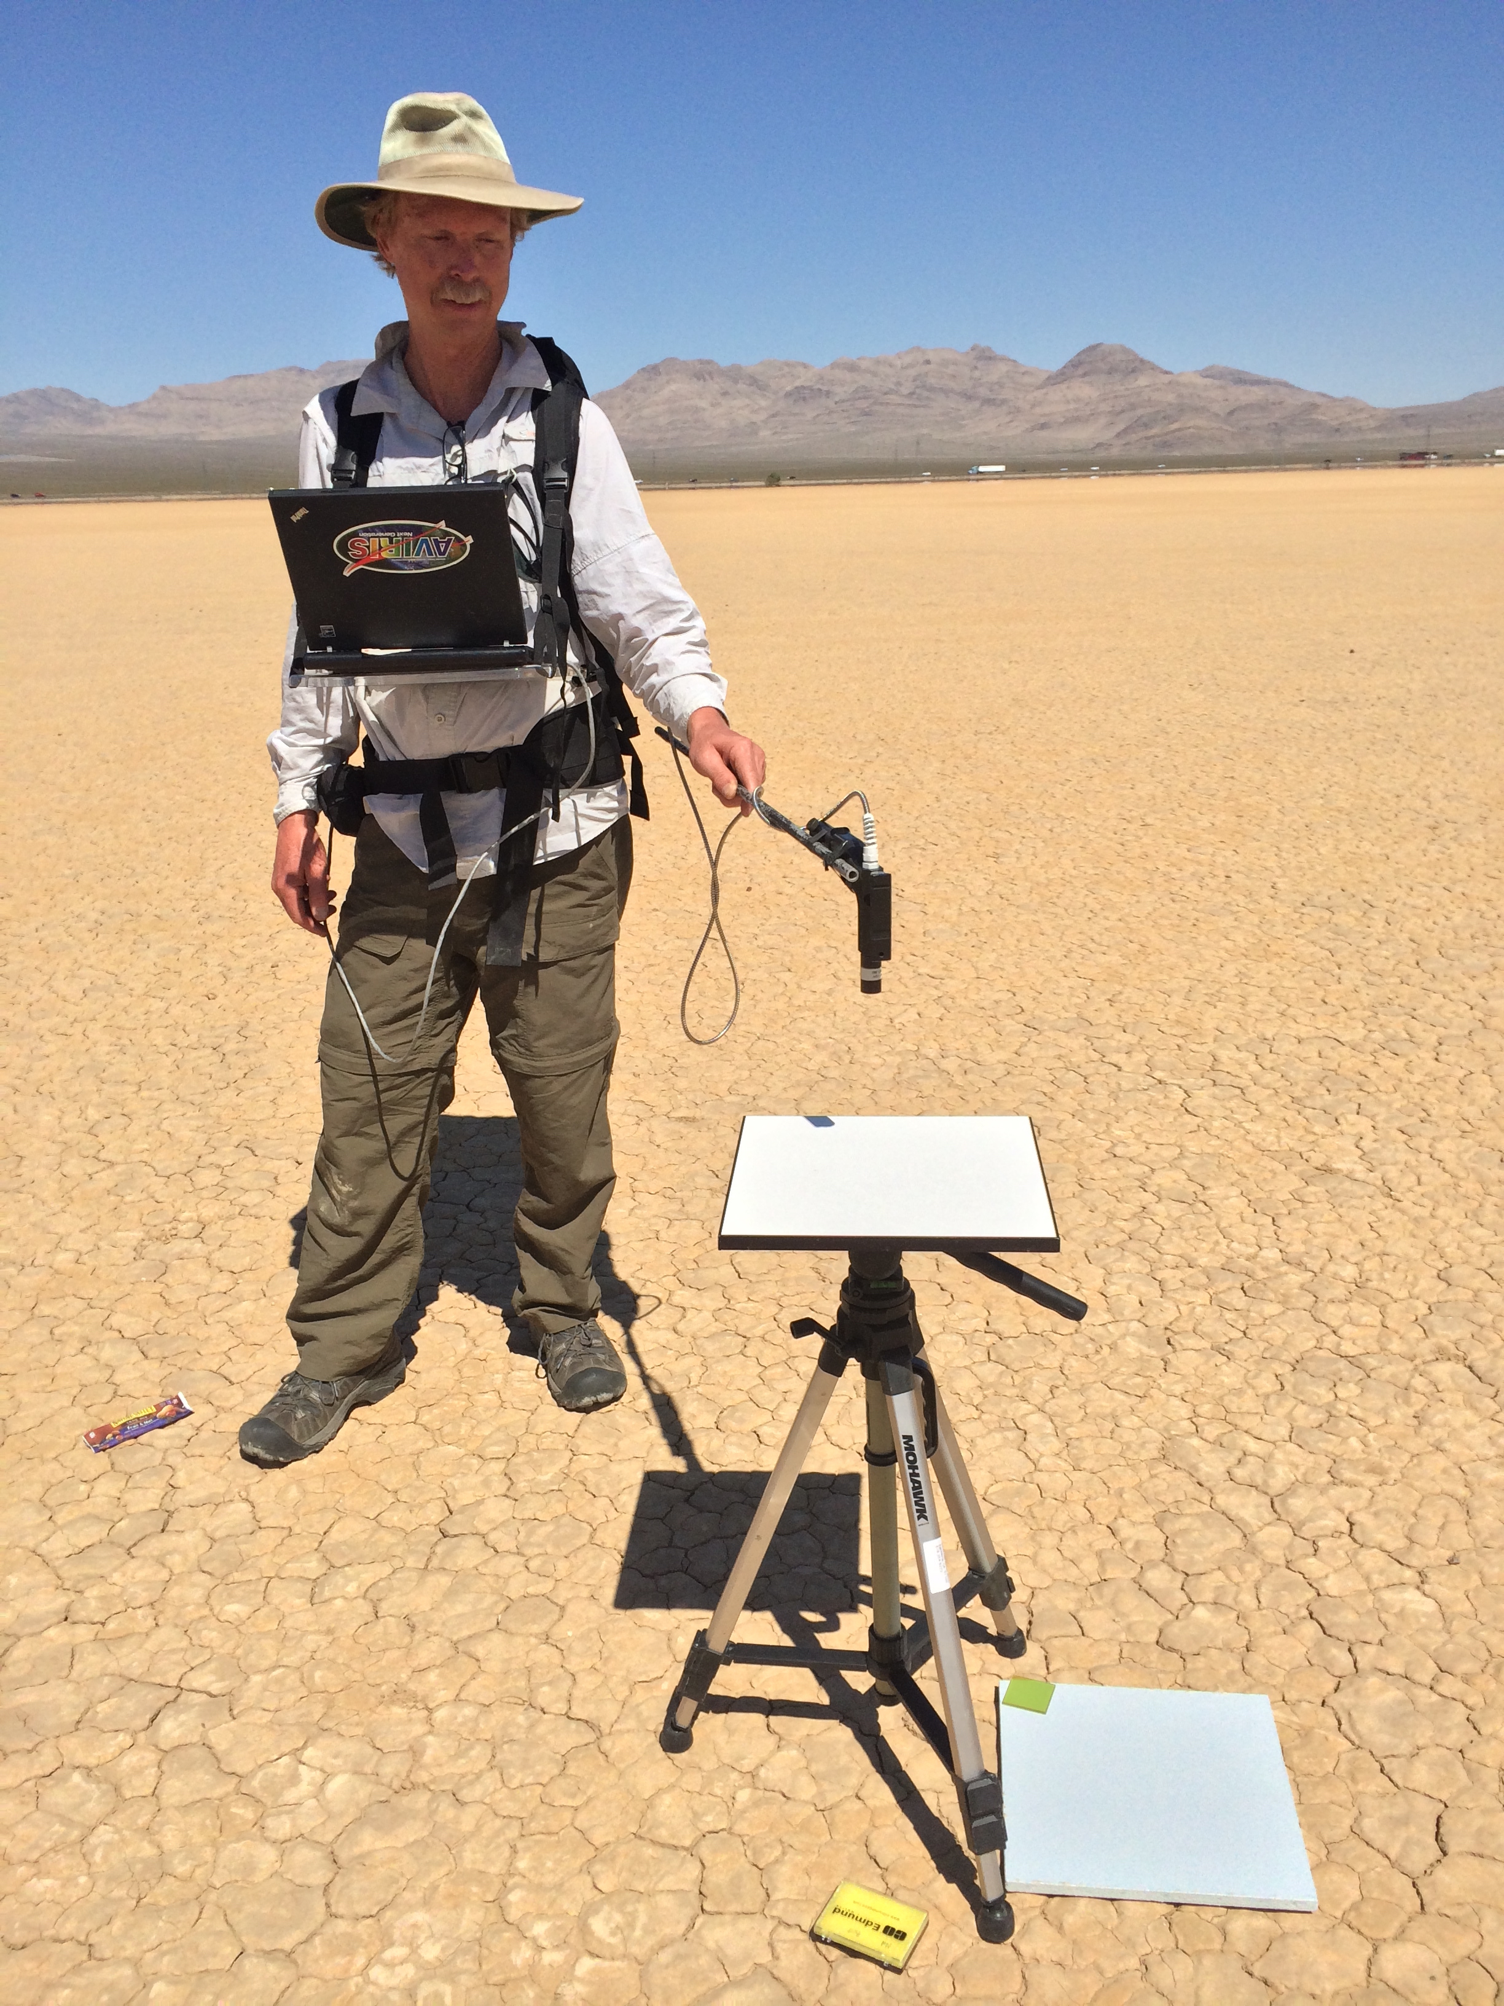
Validating atmospheric correction [Thompson et al., Surv. Geophys. 2018]
Scott Nolte, JPL
Notes:
Posterior uncertainty predictions (grey envelopes) accurately predict and capture our actual discrepancies!
This demonstrates a closed account of the uncertainty in the system. To our knowledge, this is the first time it has been done for VSWIR imaging spectroscopy.
Note: we also account for the uncertainty in the surface measurement, which is a significant contributor to the confidence bands.

Slide 9
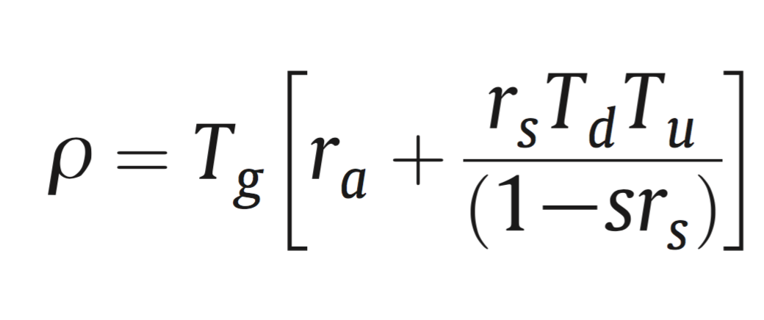
Decoupled RTM approximation
Gas absorption
Surface reflectance
Transmittance due to scattering
Path reflectance
Spherical albedo
Aerosols
(absorption and scattering)
H₂O column vapor
(absorption)
[Tanre et al., 1990;
Gao et al., 1993; Thompson et al., 2015]
Surface reflectance

Slide 10
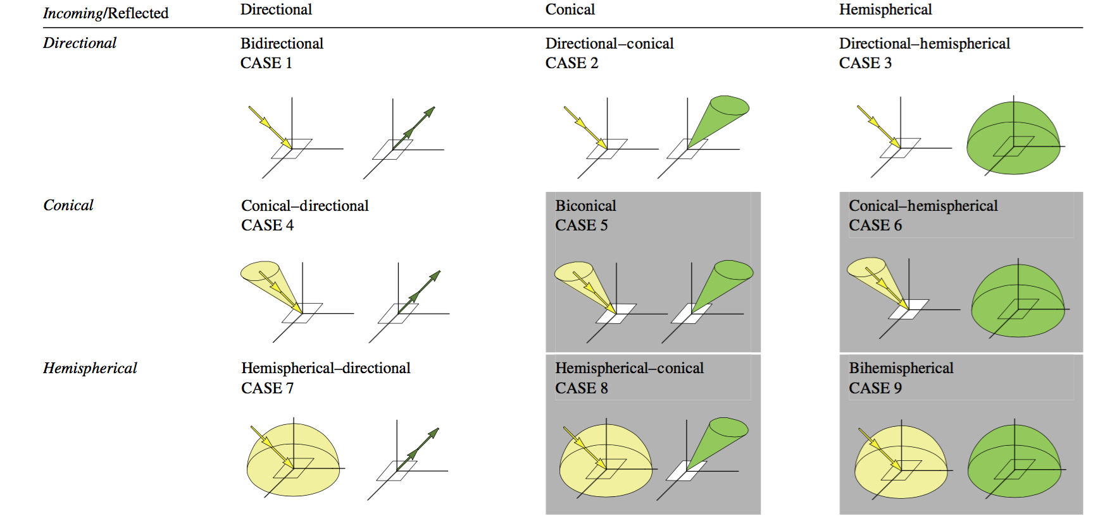
Reflectance quantities
Schaepman-strub et al., RSE 2006

Slide 11
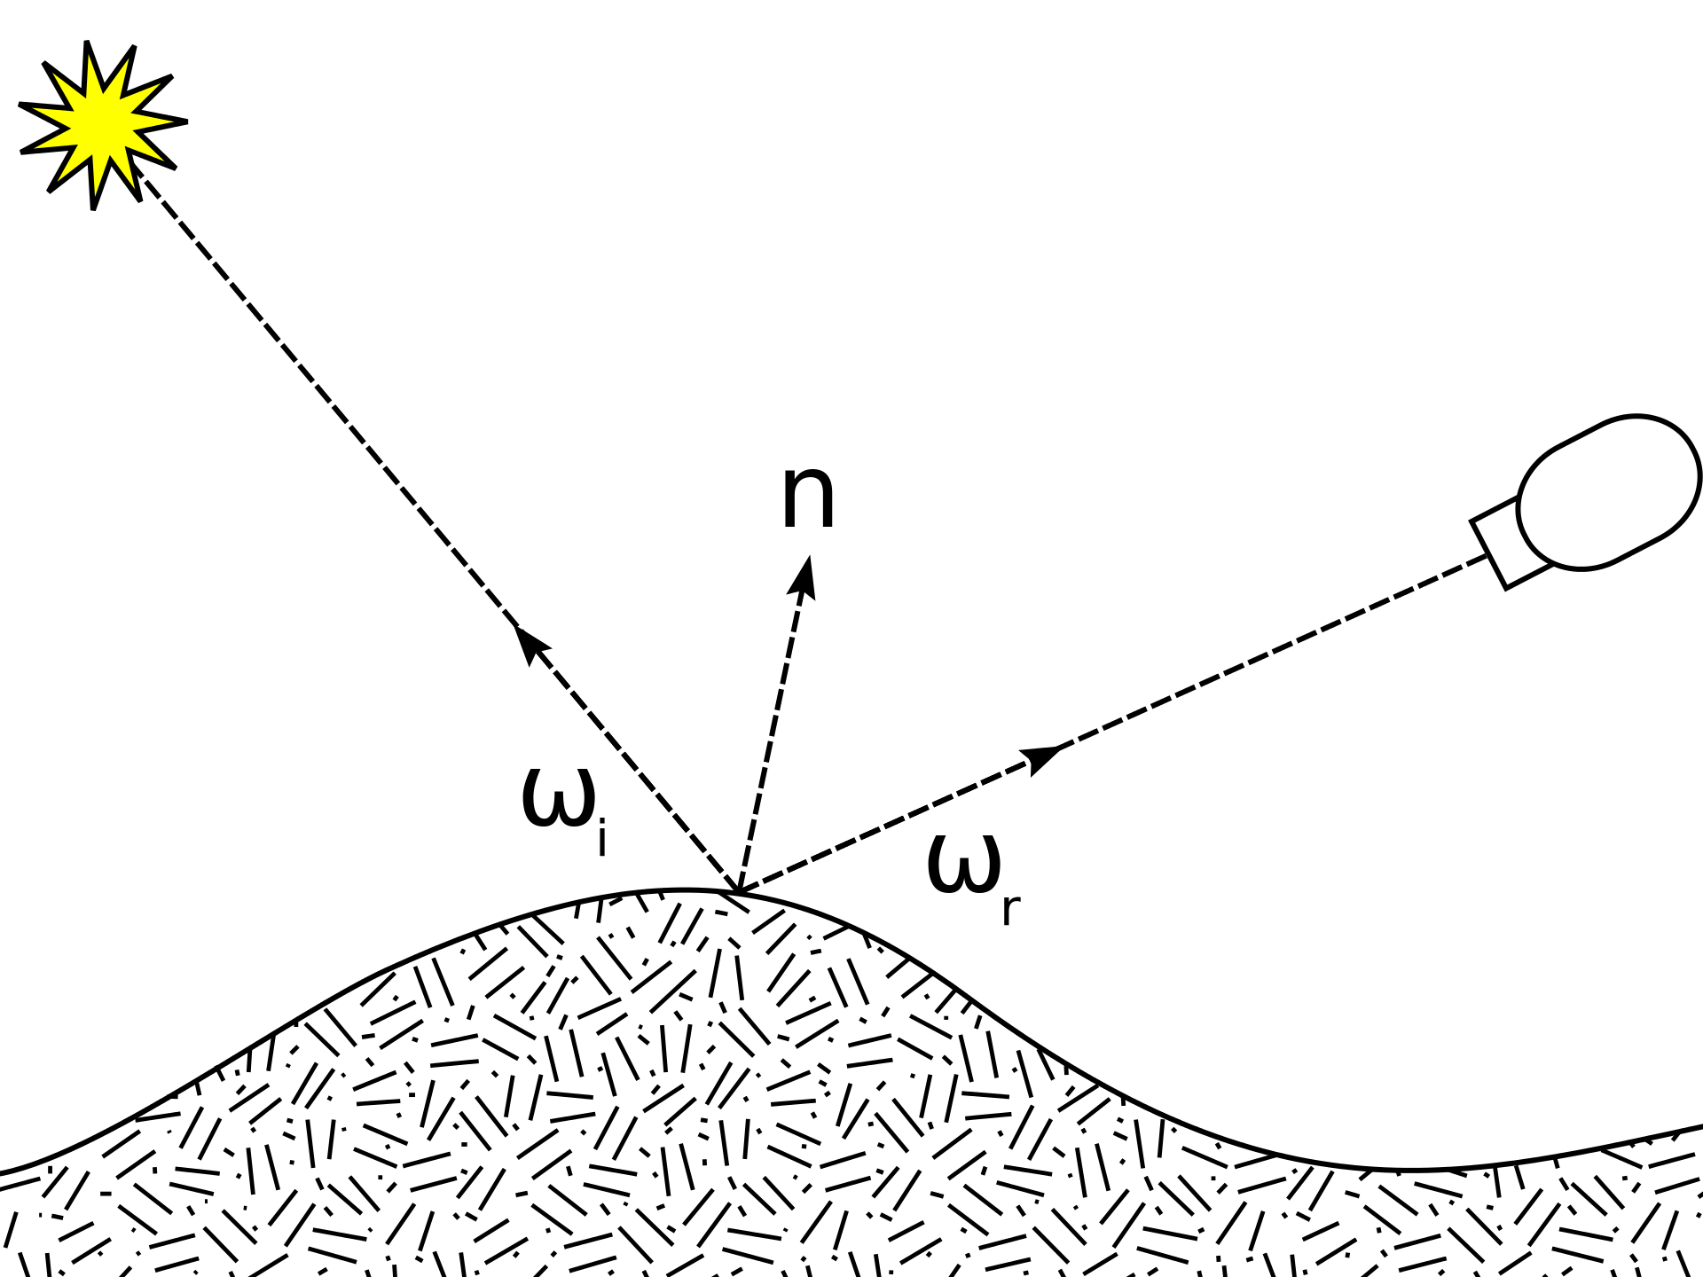
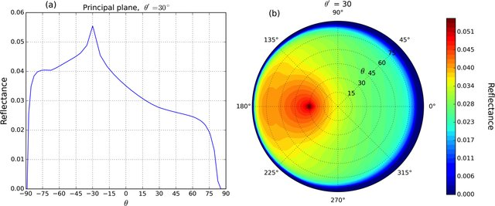
Lambertian assumption, BRDFs
Parametric or data-driven models can parameterize departures from anisotropic reflectance. Below: the Ross-Li Vegetation BRDF.
Images: Wikimedia, Ross-Li kernel from Lorente et al., The importance of surface reflectance anisotropy for cloud and NO2 retrievals from GOME-2 and OMI, July 2018 Atmospheric Measurement Techniques 11(7):4509-4529

Slide 12
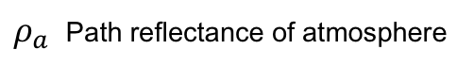
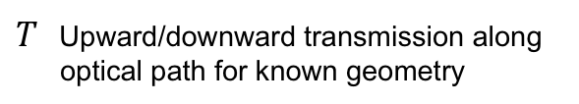
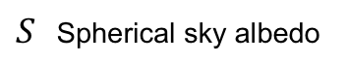
“Classic” atmospheric correction
Lookup table indexed by H₂O, etc.
1. In advance, do RTM calculations for a grid of atmospheric conditions:
$ρ_{a}$ Path reflectance of atmosphere
$S$ Spherical sky albedo
$T$ Upward/downward transmission along optical path for known geometry
Notes:
With atmospheric state specified, We can get optical constants via linear lookup table interpolation (note: T=transmission, S=spherical sky albedo, rho_a is the path reflectance).
This is just one of several similar functional approximations to the actual radiative transfer solution. With atmosphere specified, we can invert it algebraically to recover the surface reflectance.
The conventional strategy is limited in sever

Slide 13
“Classic” atmospheric correction
2. Analyze radiance to estimate this atmosphere (typically using band ratios).
Lookup table indexed by H₂O, etc.
1. In advance, do RTM calculations for a grid of atmospheric conditions:
$ρ_{a}$ Path reflectance of atmosphere
$S$ Spherical sky albedo
$T$ Upward/downward transmission along optical path for known geometry
Notes:
With atmospheric state specified, We can get optical constants via linear lookup table interpolation (note: T=transmission, S=spherical sky albedo, rho_a is the path reflectance).
This is just one of several similar functional approximations to the actual radiative transfer solution. With atmosphere specified, we can invert it algebraically to recover the surface reflectance.
The conventional strategy is limited in sever

Slide 14
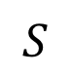
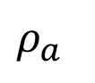
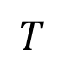
“Classic” atmospheric correction
2. Analyze radiance to estimate this atmosphere (typically using band ratios).
3. Look up and/or interpolate optical coefficients
Lookup table indexed by H₂O, etc.
$ρ_{a}$
$$S$$
$$T$$
1. In advance, do RTM calculations for a grid of atmospheric conditions:
$ρ_{a}$ Path reflectance of atmosphere
$S$ Spherical sky albedo
$T$ Upward/downward transmission along optical path for known geometry
Notes:
With atmospheric state specified, We can get optical constants via linear lookup table interpolation (note: T=transmission, S=spherical sky albedo, rho_a is the path reflectance).
This is just one of several similar functional approximations to the actual radiative transfer solution. With atmosphere specified, we can invert it algebraically to recover the surface reflectance.
The conventional strategy is limited in sever

Slide 15
“Classic” atmospheric correction
2. Analyze radiance to estimate this atmosphere (typically using band ratios).
3. Look up and/or interpolate optical coefficients
Surface reflectance
TOA reflectance
Lookup table indexed by H₂O, etc.
4. Algebraic Inversion
1. In advance, do RTM calculations for a grid of atmospheric conditions:
$ρ_{a}$ Path reflectance of atmosphere
$S$ Spherical sky albedo
$T$ Upward/downward transmission along optical path for known geometry
Notes:
With atmospheric state specified, We can get optical constants via linear lookup table interpolation (note: T=transmission, S=spherical sky albedo, rho_a is the path reflectance).
This is just one of several similar functional approximations to the actual radiative transfer solution. With atmosphere specified, we can invert it algebraically to recover the surface reflectance.
The conventional strategy is limited in sever

